Slide 1


Lecture #0
CSE332
INDUSTRY ETHICS AND LEGAL ISSUES

Slide 2
Course Overview
CSE510, Lovely Professional University, Phagwara
L T P : Credits:2
Text Book:
1. ETHICS IN INFORMATION TECHNOLOGY by GEORGE W REYNOLDS, CENGAGE LEARNING
Reference books:
“INTELLECTUAL PROPERTY RIGHTS-LAW AND PRACTICE” by ICSI House, 22, Institutional Area, Lodi Road, New Delhi 110 003
2 | 0 | 0

Slide 3
Marks Breakup:
* 2 Best CA out of 3 CA (Class test, MCQ).
CA1 (Class Test) will be held on 5th Week
CA2 (Class Test) Will be held on 9th Week
CA3 (Class Test) Will be held on 12th Week
Activity | Marks
Attendance | 5
Continuous Assessment (CA)* | 25
Mid-Term Examination (MTE) | 20
End-Term Examination (ETE) | 50
Total | 100
CSE332, Lovely Professional University

Slide 4

What is an Industry ethics and legal issues

Slide 5
What is an Industry?
Any type of Economic Activity producing products or
Services.
Economic activity is the activity of making, providing, purchasing, or selling goods or services.
It is part of a chain –from raw materials to finished product, finished product to service sector, and service sector to research and development.
Eg:-Google Assistant(product) launched by Google

Slide 6
ETHICS

Slide 7

ETHIC! a big question mark

Slide 8
Ethics
Computer ethics is a system of moral standards or values used as a guideline for computer users.
Eg:- Google has released what is effectively a rulebook for how the company will apply AI technology
The seven principles include making sure that AI is applied to applications that are socially beneficial, safe and won't create unfair bias.

Slide 9
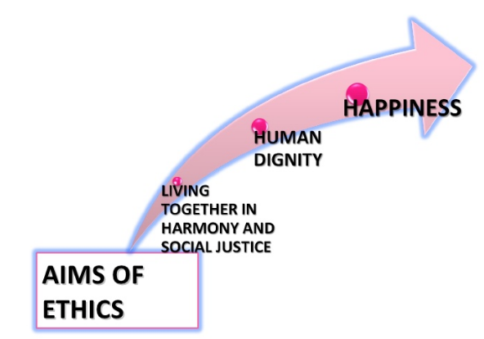


Slide 10
Legal Issues
A legal issue can be any question of law that arises from a particular set of facts.
To prevent the misuse of computers.
Eg:- Copying and Legal Issues
make sure your research and development teams thoroughly research the patents and copyrights of your current product, to avoid a messy legal battle should you step on a competitor's toes.

Slide 11
Learning Outcomes
By the end of this course students will be able to:
To understand ethical environment of work.
Understand about the latest trends and current issues in information technology.
Describe the various types of funding and schemes for start up business in IT sector.
Comply with various cyber laws and related semantics for deploying security mechanisms in IT industry.
Understand various types of legal, ethical and professional issues in Information Security.
Understand the concept of intellectual properties.

Slide 12









6
UNITS
Notes:
Along the way we’ve discovered…

Slide 13
UNIT 1
Ethics
What is an ethical work environment,
Ethical behavior of IT professional.
Common ethical issues for IT users

Slide 14
UNIT 2
Companies
What are the companies act
What is NASSCOM,
encouraging, promoting and boosting the export of software from India
What is STPI
And Recent technology advancement,
Notes:
NASSCOM, a not-for-profit industry association, is the apex body for the 154 billion dollar Indian IT BPM industry.
Software Technology Parks of India is a society established in 1991 by the Indian Ministry of electronics and Information Technology with the objective of encouraging, promoting and boosting the export of software from India

Slide 15
UNIT 3
Government Funding and schemes for Startup
What are Startups.
Benefit of startups.

Slide 16
UNIT 4
Startup in IT
Idea
Planning
General company Description,
Marketing plan,
Operational plan, Management
And the most important…………...

Slide 17


Slide 18
UNIT 5
Legal, Ethical and Professional issues in Information Security:
What is Cyber Crime?
Cyber law of India
Need for cyber law in India

Slide 19
UNIT 6
What is Intellectual Properties ?
What is the need?
How we can do it

Slide 20

Intellectual Properties
Artistic works such as music and writings; scientific or nonscientific discoveries and intangible creations inventions; developed words, symbols

Slide 21
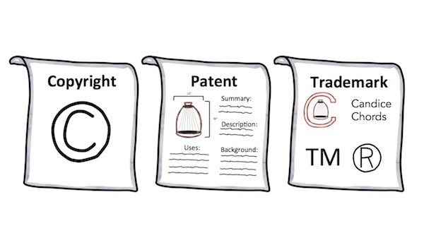
Types of IP
Notes:
ownership of artistic works,

Slide 22
Copyrights were created to protect ownership of artistic works, including artsy, literary, musical and theatrical creations.
Ideas cannot be copyrighted.
copyright generally lasts for the duration of the author’s life in addition to 70 years following their death.
Patents are intellectual property rights granted to inventions. Materials which are patentable include industrial processes, machines, chemical compositions
A trademark is a recognizable insignia, phrase, word, or symbol that denotes a specific product and legally differentiates it from all other products of its kind.

Slide 23
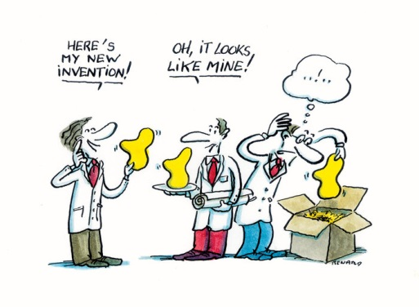
NEED

Slide 24

CSE510, Lovely Professional University, Phagwara
Thank You !!!

Slide 25
ETHICS
UNIT 1

Slide 26
ETHICS
Ethics is the field of study that is concerned with questions of value, i.e., judgments about what human behavior is "good" or "bad" in any given situation. Ethics are the standards, values, morals, principles, etc., which are used to base one's decisions or actions on; often there is no clear "right" or "wrong" answer.

Slide 28
Answer the question
What does it mean for an individual to act in an ethical manner? What does it mean for an organization to act ethically?
How should an organization balance its resources between pursuing its primary mission for existence and striving to meet social responsibility goals?

Slide 29
Ethics and Morality
Ethics refers to standards of conduct, standards that indicate how one should behave based on moral duties and virtues, which themselves are derived from principles of right and wrong.

Slide 30
Moral Relativism
Values are determined by the society we grow up in, and there are no universal values. Moral values are simply customs or conventions that vary from culture to culture.

Slide 31
The Relationship Between
Ethics and Law
If everyone made the same ethical decisions with the same results, there would be no need for law. In the real world, however, some people engage in conduct that most people agree is wrong.

Slide 32
Why Law is Necessary
Law is the system of rules of conduct established by the government of a society to maintain stability and justice.
Law defines the legal rights and duties of the people and provides the means of enforcing these rights and duties.

Slide 33
Ethics and Legal Conflicts
Because law is made by people, it is imperfect.
Legislators and judges bring their own personal opinions on ethics to the lawmaking process.
As a result, ethics and law will sometimes conflict.

Slide 34
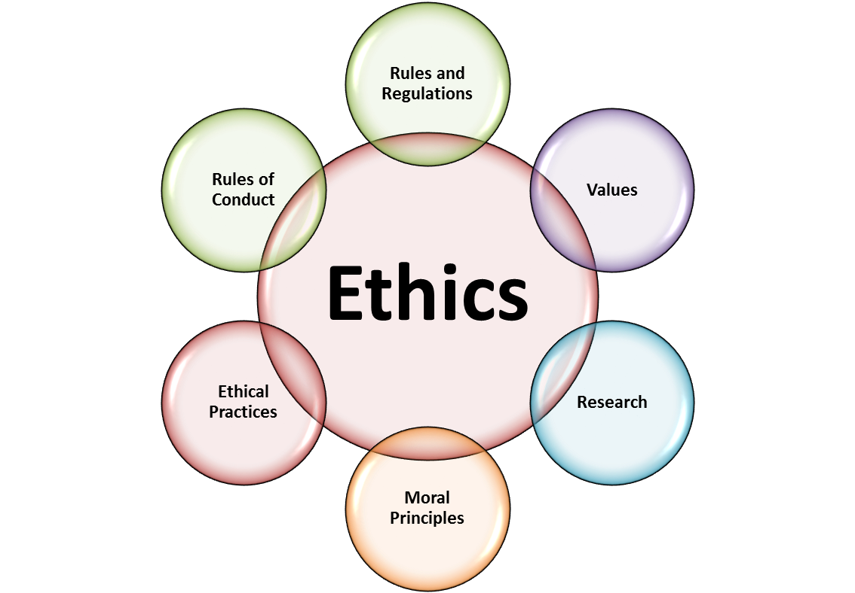
Ethics

Slide 35
Software Piracy
The software is being copied or used in a way that violates the terms of service. This often is cited as a cause for low sales of a piece of software or poor profits when the software itself is very popular.
illegally making copies of software

Slide 36

Example
For example:-
Attitudes toward software piracy- the practice of illegally making copies of software or enabling others to access software to which they are not entitled—range from strong opposition to acceptance of the practice as a standard approach to conducting business.

Slide 37
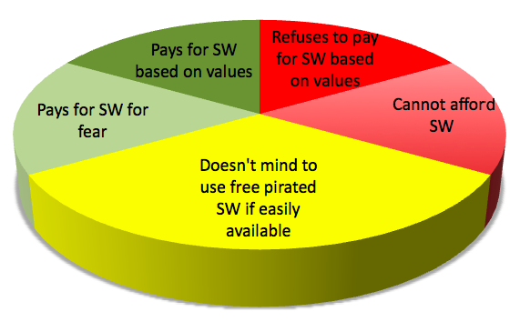
Why Piracy happens?

Slide 38
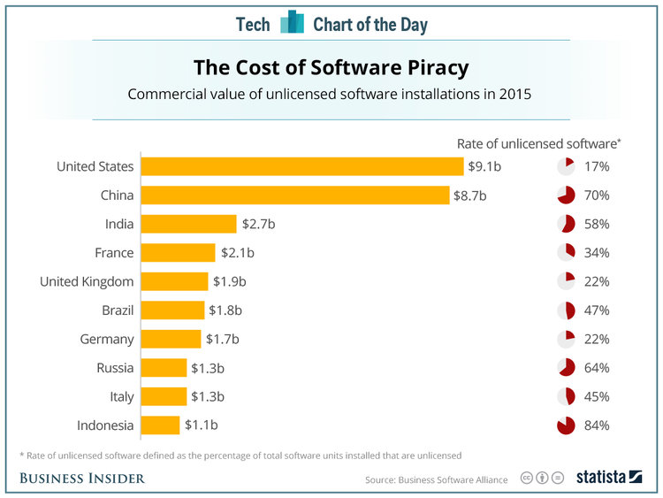
Survey

Slide 39
IMPORTANCE OF
INTEGRITY
Integrity means following your moral or ethical convictions and doing the right thing in all circumstances, even if no one is watching you. Having integrity means you are true to yourself and would do nothing that demeans or dishonour you..
Example:- Temptation of picking money or cell phone from the bench

Slide 40
Importance of integrity in business world
Open your notebook and write ,

Slide 41
ETHICS IN THE BUSINESS WORLD.
Why promoting Good business ethics is important:-
To gain the goodwill of the community.
To create an organization that operates consistently.
To produce good business .
To protect the organization and its employees from legal action.
To avoid unfavourable publicity.

Slide 42


Slide 43
To gain the goodwill of the community
Blake Mycoskie started Toms Shoes on the premise that for every pair of shoes sold, one pair would be donated to a child in need. This innovative idea resulted from a trip to Argentina where Mycoskie saw an overwhelming number of children without shoes. Toms Shoes recognized that consumers want to feel good about what they buy, and thus directly tied the purchase with the donation. In just four years, Toms Shoes has donated more than 400,000 shoes, evidence that consumers have clearly embraced the cause

Slide 44
CSR
Corporate social responsibility (CSR) is the concept that an organization should act ethically by taking responsibility for the impact of its actions on the environment, the community, and the welfare of its employees.

Slide 45
No doubt organization exist primarily for profits and customer satisfaction but they also have some basic responsibilities to society.
Philanthropy (desire) is one way in which an organization can demonstrate its values in action and make a positive connection with its stakeholders.
.

Slide 46
To create an organization that operates consistently.
Consistency also means that shareholders, customers, suppliers, and the community know what they can expect of the organization that it will behave in the future much as it has in the past
Operate with honesty and integrity, staying true to organizational principles.
Operate according to standards of ethical conduct, in words and action.
Treat colleagues, customers, and consumers with respect.
Strive to be the best at what matters most to the organization.
Value diversity.
Make decisions based on facts and principles
Notes:
Organizations develop and abide by values to create an organizational culture and to define a consistent approach for dealing with the needs of their stakeholders—shareholders, employees, customers, suppliers, and the community. Such consistency ensures that employees know what is expected of them and can employ the organization’s values to help them in their decision making

Slide 47
TO PRODUCE GOOD BUSINESS
Companies that produce safe and effective products avoid costly recalls and lawsuits.
Failing ex :
The recall of the weight loss drug Fen-Phen cost its maker, Wyeth-Ayerst Laboratories, almost $14 billion in awards to victims, many of whom developed serious health problems as a result of taking the drug.

Slide 48
Avoiding Unfavourable Publicity
In 2012, Google agreed to pay a fine of $22.5 million to end an FTC investigation into allegations that the firm utilized cookies and bypassed privacy settings to track the online habits of people using Apple’s Safari browser..
ANSWER: why did Google agree to pay?

Slide 49
The amount of the fine, while the largest in FTC history, represented less than one day’s worth of Google’s profits. Why ?
The public reputation of a company strongly influences the value of its stock, how consumers regard its products and services,
The degree of oversight it receives from government agencies,
The amount of support and cooperation it receives from its business partners.
Thus, many organizations are motivated to build a strong ethics program to avoid negative publicity

Slide 50
Improving corporate ethics
Assume one scenario, you want to start a company (any company) what type of rules you will going to make for your employee.

Slide 51
How to convert unethical to ethical env
Improving corporate ethics
Ethics Resource Centre found
Attended Ethical workshop | NOT attended ethical workshop
86% of them are perceiving strong ethical culture | 25% of them are perceive a culture that promote integrity

Slide 52
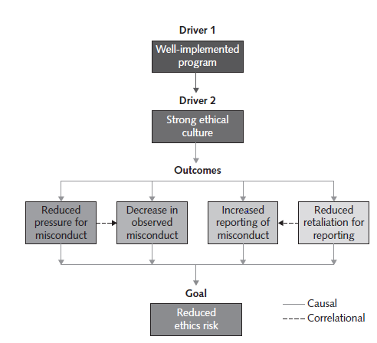

Slide 53
Characteristics of a successful ethics program
Employees are willing to seek advice about ethics issues.
• Employees feel prepared to handle situations that could lead to misconduct.
• Employees are rewarded for ethical behaviour.
• Employees feel positively about their company.

Slide 54
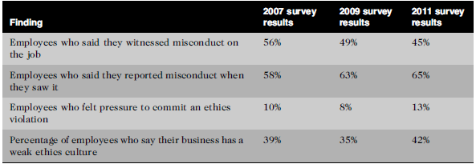
Survey after completion of workshop
National business survey

Slide 55
How can we improve business ethics ?
1) Appointing a Corporate Ethics Officer
A corporate ethics officer (also called a corporate compliance officer) provides an organization with vision and leadership in the area of business conduct.
the corporate ethics officer should be a well-respected, senior-level manager who reports directly to the CEO.
Ethics officers come from diverse backgrounds, such as legal staff, human resources, finance, auditing, security, or line operations.

Slide 56
Specific responsibilities include the following:
Responsibility for compliance—that is, ensuring that ethical procedures are put into place and consistently adhered to throughout the organization
Responsibility for creating and maintaining the ethics culture that the highest level of corporate authority wishes to have
Responsibility for being a key knowledge and contact person on issues relating to corporate ethics and principles

Slide 57
2) Establishing a Corporate Code of Ethics.
A code of conduct defines how a company’s employees should act on a day-to-day basis.
It reflects the organization’s daily operations, core values and overall company culture
every code of conduct is unique to the organization it represents.

Slide 58
3) Conducting Social Audits
conduct regular social audits of their policies and practices.
In a social audit, an organization reviews how well it is meeting its ethical and social responsibility goals, and communicates its new goals for the upcoming year.

Slide 59
4) Requiring Employees to Take Ethics Training.
The ancient Greek philosophers believed that personal convictions about right and wrong behaviour could be improved through education.
organization’s code of ethics must be promoted and continually communicated within the organization, from top to bottom.

Slide 60
Including Ethical Criteria in Employee Appraisals
Performance.
Self improvement.
Successful completion of projects.
Initiatives.
Maintenance of good customer relation.

Slide 61
Creating an Ethical Work Environment
Employees must have a knowledgeable resource with whom they can discuss perceived
unethical practices

Slide 62

DECISION

Slide 63
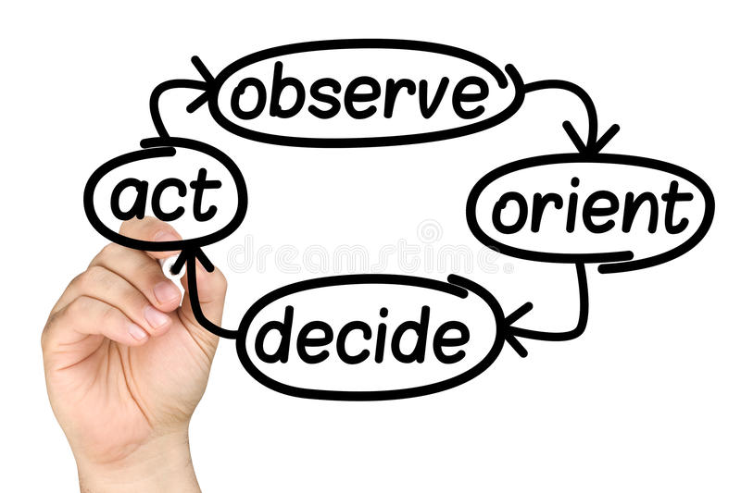
DECISION MAKING

Slide 64
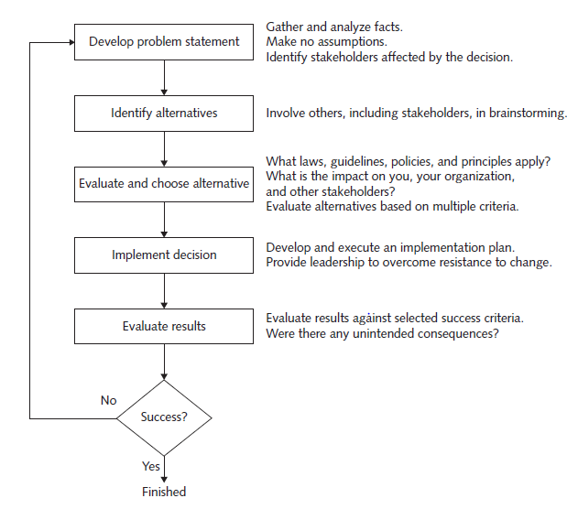
INCLUDING ETHICAL CONSIDERATIONS IN DECISION MAKING

Slide 65
DEVELOP A PROBLEM STATEMENT
A problem statement is a clear, concise description of the issue that needs to be addressed.
It Answers-
What do people observe that causes them to think there is a problem?
Who is directly affected by the problem?
Is anyone else affected?
How often does the problem occur?
What is the impact of the problem?
How serious is the problem?

Slide 66
DEVELOP A PROBLEM STATEMENT
Good problem statement: Our product supply organization is continuously running out of stock of finished products, creating an out-of-stock situation on over 15 percent of our customer orders, resulting in over $300,000 in lost sales per month.
• Poor problem statement: We need to implement a new inventory control system. (This is a possible solution, not a problem statement.)
• Poor problem statement: We have a problem with finished product inventory.(This is not specific enough.)

Slide 67
IDENTIFY ALTERNATIVES
It is ideal to enlist the help of others, including stakeholders, to identify several alternative solutions to the problem.
Brainstorming with others will increase your chances of identifying a broad range of alternatives and determining the best solution.
Try not to be critical of ideas, as any negative criticism will tend to shut down the discussion, and the flow of ideas will dry up.
Simply write down the ideas as they are suggested.

Slide 68
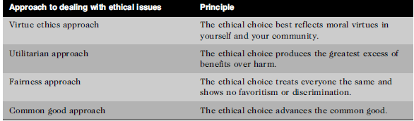
EVALUATE AND CHOOSE AN ALTERNATIVE

Slide 69
Virtue Ethics Approach
It focuses on how you should behave and think about relationships if you are concerned with your daily life in a community.
Example-honesty and openness when dealing with others are generally considered virtues; however, a corporate purchasing manager who is negotiating a multimillion dollar deal might need to be vague in discussions with potential suppliers.
Utilitarian Approach
You should choose the action or policy that has the best overall consequences for all people who are directly or indirectly affected.
Example- Business managers, legislators, and scientists weigh the benefits and harm of policies when deciding whether to invest resources in building a new plant in a foreign country, to enact a new law, or to approve a new prescription drug.

Slide 70
Fairness Approach
The fairness approach focuses on how fairly actions and policies distribute benefits and burdens among people affected by the decision.
The guiding principle of this approach is to treat all people the same.
Common Good Approach
It is based on a vision of society as a community whose members work together to achieve a common set of values and goals.
It attempt to implement social systems, institutions, and environments that everyone depends on and that benefit all people.
Examples include an effective education system, a safe and efficient transportation system, and accessible and affordable health care.

Slide 71
IMPLEMENT THE DECISION
Once an alternative is selected, it should be implemented in an efficient, effective, and timely manner.
It is often much easier said than done, because people tend to resist change.
It is imperative that someone whom the stakeholders trust and respect answer the following questions:
Why are we doing this?
What is wrong with the current way we do things?
What are the benefits of the new way for you?

Slide 72
EVALUATE THE RESULTS
After the solution to the problem has been implemented, monitor the results to see if the desired effect was achieved, and observe its impact on the organization and the various stakeholders.
  Were the success criteria fully met?
  Were there any unintended consequences?

Slide 73
ETH ICS IN INFORMATION TECHNOLOGY
Here are some examples that raise public concern about the ethical use of information technology:
Many employees have their email and Internet access monitored while at work, as employers struggle to balance their need to manage important company assets and work time with employees’ desire for privacy and self direction.
Millions of people have downloaded music and movies at no charge and in apparent violation of copyright laws at tremendous expense to the owners of those copyrights.

Slide 74
Organizations contact millions of people worldwide through unsolicited email (spam) as an extremely low-cost marketing approach.
Hackers break into databases of financial and retail institutions to steal customer information, then use it to commit identity theft—opening new accounts and charging purchases to unsuspecting victims.
Students around the world have been caught downloading material from the Web and plagiarizing content for their term papers.
Web sites plant cookies or spyware on visitors’ hard drives to track their online purchases and activities

Slide 75
You are a recent graduate of a well-respected business school, but you are having trouble getting a job. You worked with a professional résumé service to develop a well-written résumé and placed it on several Web sites; you also sent it directly to contacts at a dozen companies. So far, you have not even had an invitation for an interview. You know that one of your shortcomings is that you have no real job experience to speak of. You are considering beefing up your résumé by exaggerating the extent of the class project you worked on for a few weeks at your brother-in-law’s small consulting firm. You could reword the résumé to make it sound as if you were actually employed and that your responsibilities were greater than they actually were. What would you do?

Slide 76
ETHICS FOR IT WORKERS AND IT USERS
Lecture 4

Slide 77
Profession
A profession is a calling that requires specialized knowledge and often long and intensive academic preparation.
Professional ?

Slide 78



Professionals

Slide 79
Professional Employee
The United States Code of federal regulations defines a “professional employee” as one who is engaged in the performance of work:
requiring knowledge of an advanced type in a field of science or learning customarily acquired by a prolonged course of specialized intellectual instruction and study in an institution of higher learning
requiring the consistent exercise of discretion and judgment in its performance
which is predominantly intellectual and varied in character
which is of such character that the output produced or the result accomplished by such work cannot be standardized in relation to a given period of time

Slide 80


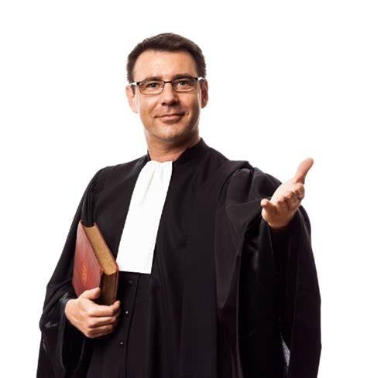
Professionals such as doctors, lawyers, and accountants require advanced training and experience; they must exercise discretion and judgment in the course of their work; and their work cannot be standardized.

Slide 81
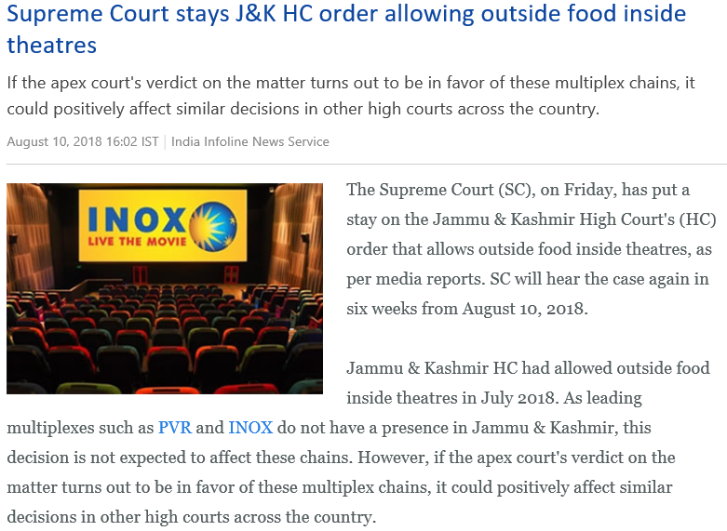
Many professional roles carry special rights and responsibilities

Slide 82
Are IT Workers Professionals?
IT Professional can be:
  Marketing analysts, financial consultants, and IT specialists such as mobile application developers, software engineers, systems analysts, and network administrators.
One could argue, however, that not every IT role requires “knowledge of an advanced type in a field of science or learning customarily acquired by a prolonged course of specialized intellectual instruction and study,” to quote again from the United States Code.
From a legal perspective, IT workers are not recognized as professionals because they are not licensed by the state or federal government
Notes:
Morally yes ethically no

Slide 83
IT workers often have the skills and knowledge to abuse systems and data or to enable others to do so.
Software piracy is an area in which IT workers may be tempted to violate laws and policies. Although end users often get the blame when it comes to using illegal copies of commercial software
Software piracy in a corporate setting is sometimes directly traceable to IT staff members—either they allow it to happen or they actively engage in it, often to reduce IT-related spending.

Slide 84
Common Ethical Issues for IT Users
1) Software Piracy
software piracy in a corporate setting can sometimes be directly traceable to IT professionals—they might allow it to happen, or they might actively engage in it.
Sometimes IT users are the ones who commit software piracy. A common violation occurs when employees copy software from their work computers for use at home. When confronted, the IT user’s argument might be: “I bought a home computer partly so I could take work home and be more productive; therefore, I need the same software on my home computer as I have at work.”

Slide 85
2) Inappropriate Use of Computing Resources
Some employees use their computers to surf popular Web sites that have nothing to do with their jobs, participate in chat rooms and play computer games. These activities eat away at worker productivity and waste time.
Example :- executive director of the Pentagon’s Missile Defence Agency issued a memo to its 8,000 employees warning them to stop using their work computers to access Internet objectionable sites. One concern of government officials is that these sites are infected with computer viruses and other malware; criminals and foreign intelligence agencies often use such sites as a means to gain access to government and corporate computer networks. For example, a foreign agent can embed malware capable of stealing data or opening computer communications ports whenever certain photos or videos are downloaded to a computer

Slide 86
3) Inappropriate Sharing of Information
Every organization stores vast amounts of information that can be classified as either private or confidential. Private data describes individual employees—for example, their salary information, attendance data, health records, and performance ratings. Private data also includes information about customers—credit card information, telephone number, home address, and so on.
Notes:
In late 2010, hundreds of thousands of leaked State Department documents were posted on the WikiLeaks Web site. As of this writing, it appears that the source of the leaks was a low-level IT user (an Army private) with access to confidential documents. The documents revealed details of behind-the-scenes international diplomacy, often divulging candid comments from world leaders and providing particulars of U.S. tactics in Afghanistan,
Iran, and North Korea

Slide 87
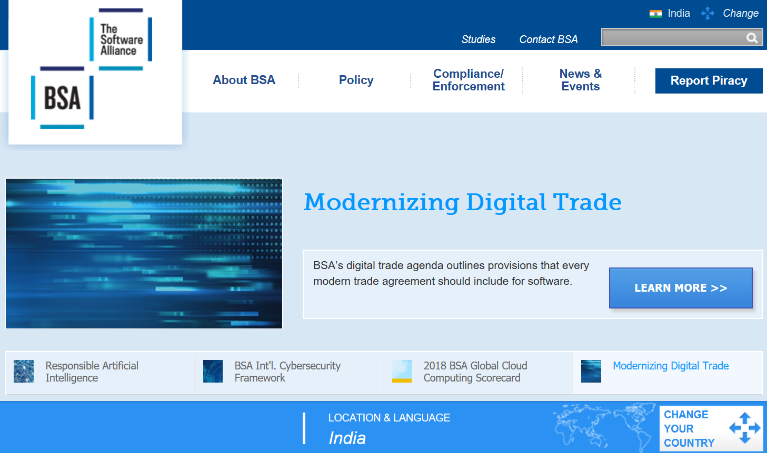
Business Software Alliance (BSA)
The Business Software Alliance (BSA) is a trade group that represents the world’s largest software and hardware manufacturers.
Its mission is to stop the unauthorized copying of software produced by its members. BSA is funded both through dues based on member companies’ software revenues and through settlements from companies that commit piracy.
BSA membership includes two dozen or so members such as Adobe, Apple, Intel, McAfee, Microsoft, Symantec, and The Math Works

Slide 88
More than 100 BSA lawyers and investigators prosecute thousands of cases of software piracy each year.
BSA investigations are usually triggered by calls to the BSA hotline, reports sent to the BSA Web site (www.nopiracy.org), and referrals from member companies.
Many of these cases are reported by disgruntled employees or former employees.

Slide 89
Failure to cooperate with the BSA can be extremely expensive.
The cost of criminal or civil penalties to a corporation and the people involved can easily be many times more expensive than the cost of “getting legal” by acquiring the correct number of software licenses.
Software manufacturers can file a civil suit against software pirates with penalties of up to $150,000 per copyrighted work.
The government can criminally prosecute violators and fine them up to $250,000, incarcerate them for up to five years, or both.
Example:
In 2012, the Alexander Automotive Group paid $325,000 to settle claims that it was using unlicensed Microsoft software on its computers. As part of the settlement agreement with BSA, the firm deleted all unlicensed copies of software from its computers, purchased the licenses required to become compliant, and agreed to implement more effective software management procedures. BSA was alerted to this situation by a report sent to its Web site

Slide 90
Trade secret
A trade secret is information, generally unknown to the public, that a company has taken strong measures to keep confidential. It represents something of economic value that has required effort or cost to develop and that has some degree of uniqueness or novelty.
Example
Colonel’s secret recipe of 11 herbs and spices used to make the original KFC chicken, the formula for Coke, and Intel’s manufacturing process for the i7 quad core processing chip.
Employers worry that employees may reveal these secrets to competitors, especially if they leave the company. As a result, companies often require employees to sign confidentiality agreements and promise not to reveal the company’s trade secrets.

Slide 91
Supporting the Ethical Practices of IT Users
The growing use of IT has increased the potential for new ethical issues and problems; thus, many organizations have recognized the need to develop policies that protect against abuses.
Establishing Guidelines for Use of Company Software:-
clear rules that govern the use of home computers and associated software
companies negotiate contracts with software manufacturers and provide PCs and software so that IT users can work at home

Slide 92
Defining the Appropriate Use of IT Resources:-
Companies must develop, communicate, and enforce written guidelines
Effective guidelines allow some level of personal use while prohibiting employees from visiting objectionable Internet sites
Structuring Information Systems to Protect Data and Information:-
Organizations must implement systems and procedures that limit data access to just those employees who need it.
For example, sales managers may have total access to sales and promotion databases through a company network, but their access should be limited to products for which they are responsible.

Slide 93
Installing and Maintaining a Corporate Firewall
A firewall can be configured to serve as an effective deterrent to unauthorized Web surfing by blocking access to specific objectionable Web sites

Slide 94
Certification and licensing
Certification indicates that a professional possesses a particular set of skills, knowledge, or abilities, in the opinion of the certifying organization.
Licensing applies only to people and is required by law, certification can also apply to products (e.g., the Wi-Fi CERTIFIED logo assures that the product has met rigorous interoperability testing to ensure that it will work with other Wi-Fi-certified products) and is generally voluntary.
IT-related certifications may or may not include a requirement to adhere to a code of ethics, whereas such a requirement is standard with licensing.

Slide 95
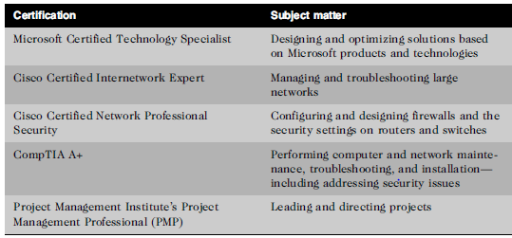
Vendor Certifications
Many IT vendors—such as Cisco, IBM, Microsoft, SAP, and Oracle—offer certification programs for those who use their products
Example:- Cisco Certified Internetwork Expert (CCIE) certification, also require a hands-on lab exam that demonstrates skills and knowledge
Industry Association Certifications

Slide 96
Government Licensing
A government license is government-issued permission to engage in an activity or to operate a business.
Countries have enacted legislation to establish licensing requirements and protect public safety in a variety of fields
Example :- National Council of Examiners for Engineering and Surveying (NCEES) has developed a professional exam for electrical engineers and computer engineers

